Slide 1
SQL Queries

Slide 2
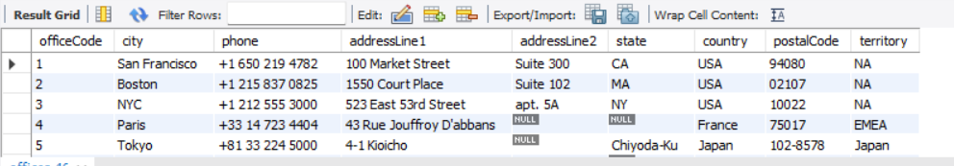
Select statement:
select * from offices;
Displays all columns and rows from offices table.

Slide 3
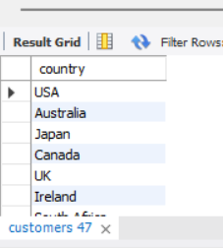
DISTINCT + WHERE:
select distinct country from customers where state is not null;
Shows unique customer countries where state information exists.

Slide 4
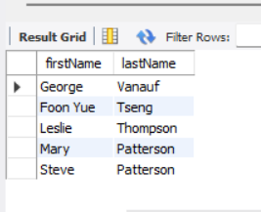
Order by:
select firstName, lastName from employees order by lastName desc, firstName asc limit 5;
Retrieves top 5 employees sorted by last name (descending) and first name (ascending).

Slide 5
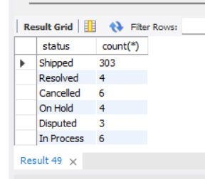
group by:
select status,count(*) from orders group by status;
Counts the number of orders for each status.

Slide 6
Aggregate functions:
select status,sum(priceEach * quantityOrdered) as Sum from orders join orderdetails on orders.orderNumber=orderdetails.orderNumber group by status;
Calculates total revenue grouped by order status. Refer S1
select Year(orderDate) as Year, sum(priceEach * quantityOrdered) as Sum from orders join orderdetails on orders.orderNumber=orderdetails.orderNumber where status = 'Shipped' group by Year having Year > 2000;
Shows yearly shipped revenue for years after 2000. Refer S2
select Year(orderDate) as Year, status, avg(priceEach * quantityOrdered) as AvgSum from orders join orderdetails on orders.orderNumber=orderdetails.orderNumber group by Year,status order by year;
Calculates average order value by year and status. Refer S3

Slide 7
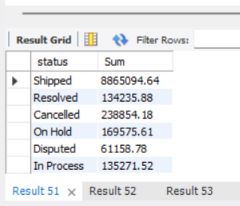
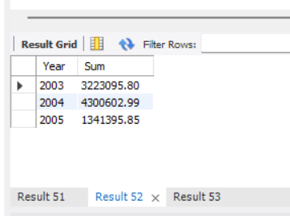
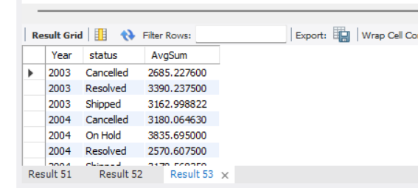
S3
S1
S2

Slide 8
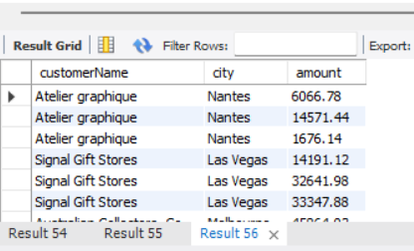
Joins:
select distinct customerName, city, amount from customers inner join payments on customers.customerNumber = payments.customerNumber;
select distinct customerName, city, amount from customers left join payments on customers.customerNumber = payments.customerNumber;
select distinct customerName, city, amount from customers right join payments on customers.customerNumber = payments.customerNumber;Counts the number of orders for each status.

Slide 9
Subquery:
select firstName from employees where officeCode in (select officeCode from offices where country='USA’);
Retrieves employees working in USA offices. Refer S1
select productCode from (select productCode from orderdetails where quantityOrdered > 40) as MostQuantity;
Retrieves product codes with large order quantities. Refer S2
SELECT productname, buyprice FROM products p1 WHERE buyprice > (SELECT AVG(buyprice) FROM products WHERE productline = p1.productline);
Shows products priced above their product line average. Refer S3

Slide 10
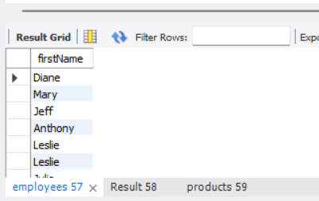
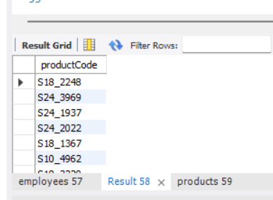
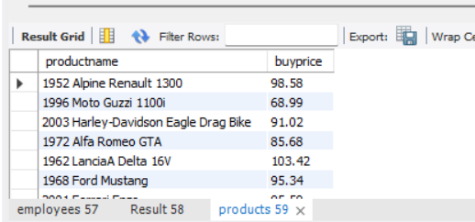
S3
S1
S2

Slide 11
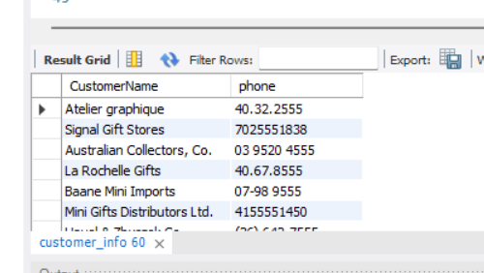
Views:
create view customer_info asselect CustomerName, phone from customers;
Creates a virtual table showing customer names and phone numbers.
select * from customer_info;

Slide 12
Index:
CREATE INDEX idx_orders_orderDateON orders(orderDate);
Creates an index to speed up queries filtering or sorting by orderDate..

